Slide 1

Gibbs Sampling for Bayesian Inference of Epidemic Parameters in the SIR Model
MATH 212 — NUMERICAL ANALYSIS FINAL PROJECT
Sai Nikhil Chanda
April 22, 2026
dS/dt = −β(I/N)S
dI/dt = β(I/N)S − γI
dR/dt = γI

Slide 2
Why Epidemic Parameter Estimation?
Motivation for Bayesian inference of SIR model parameters
Public Health Policy
Limited Data
Understanding how fast a disease spreads — R₀ = β/γ — is critical for guiding intervention and policy decisions.
Large epidemiological datasets are often unavailable or expensive, requiring robust statistical inference methods.
Beyond Point Estimates
Intractable Posteriors
Bayesian methods provide full posterior distributions of β and γ, enabling rigorous uncertainty quantification.
The posterior involves solving ODEs, making analytical solutions impossible — MCMC methods are essential.

Slide 3
SECTION 2.1
Mathematical Prerequisites
Random Variables & Probability
Likelihood & Bayesian Inference
Markov Chains
A random variable X has density f(x) satisfying
Likelihood from i.i.d. sample x₁,…,xₙ :
Markov property:
∫ f(x) dx = 1
L(θ | x) = ∏ f(xᵢ | θ)
P(Xₜ = i | X₀,…,Xₜ₋₁) = P(Xₜ = i | Xₜ₋₁)
Normal distribution:
MLE: find θ̂ such that dL/dθ = 0
Transition matrix P with entries
f(x | μ, σ²) = (2πσ²)−½ exp(−(x−μ)² / 2σ²)
Bayesian: θ is random with prior π(θ)
pᵢⱼ = P(Xₜ₊₁ = j | Xₜ = i)
Binomial distribution:
Bayes' Rule:
Distribution evolves as
f(x | n, p) = C(n,x) · px · (1−p)n−x
f(θ | x) = f(x | θ) · π(θ) / f(x)
μₜ = μ₀ · Pᵗ
Monte Carlo integration approximates posterior expectations via sampling
Stationary dist.
π = π · P
Ergodic DTMC (finite, irreducible, aperiodic): unique π with all π(i) > 0; μ₀Pᵗ → π
Ergodicity guarantees MCMC convergence to the target posterior

Slide 4
The SIR Model
Susceptible – Infectious – Recovered Compartmental Model
S
β
I
γ
R
SUSCEPTIBLE
INFECTIOUS
RECOVERED
S(t)
I(t)
R(t)
Individuals capable of contracting the disease. They have no immunity and can become infected upon contact.
Currently infected individuals who can transmit the disease to susceptible individuals in the population.
Individuals who have recovered and gained permanent immunity. They can no longer be infected or transmit disease.
dS/dt = −β(I/N)S
dI/dt = β(I/N)S − γI
dR/dt = γI
N = S + I + R at all times
β
Infection rate
γ
Recovery rate
R₀ = β/γ
Basic reproduction number
R₀ > 1 → disease spreads

Slide 5
Bayesian Inference Framework
A four-step pipeline from observed data to posterior samples
1
2
3
4
Observe Data
Specify Priors
Compute Posterior
Sample via MCMC
xt ~ Poisson(ΔIt(θ))
β ~ Gamma(αβ, bβ)
γ ~ Gamma(αγ, bγ)
f(β,γ|x) ∝ f(x|β,γ)·π(β)·π(γ)
(β, γ)(k) → f(β,γ|x)
⚠ Likelihood requires solving ODEs
Key Insight: The posterior has no closed-form solution because evaluating the likelihood at each (β, γ) requires numerically solving the SIR differential equations — making MCMC sampling essential.

Slide 6
The Gibbs Sampling Algorithm
Comparing the ideal sampler with the practical implementation
Pure Gibbs Sampler
Metropolis-within-Gibbs
THEORETICAL
USED HERE
For iteration k = 1, …, M :
Full conditionals have no closed form — the likelihood involves solving ODEs at each step.
1
Sample β(k) from
π(β | γ(k−1), x)
1
Propose β′ from a normal random walk:
β′ ~ 𝒩(β(k−1), σ²β)
2
Sample γ(k) from
π(γ | β(k), x)
VS
2
Compute log-posterior ratio and accept/reject β′ with MH probability
3
Repeat for γ using the same Metropolis-Hastings sub-step
Simple alternating conditional sampling
Requires closed-form full conditionals
Retains convergence guarantees of the Gibbs framework via ergodicity
Each Gibbs update becomes a Metropolis-Hastings step when closed-form conditionals are unavailable

Slide 7
Convergence Guarantee
"
THEOREM
Let π(θ₁, θ₂) be a joint distribution with strictly positive density and well-defined full conditionals. Then the Gibbs sampler defines an ergodic Markov chain with stationary distribution π, and the total variation distance converges to 0 as k → ∞.
Casella & George (1992)
Ergodicity ensures that MCMC samples converge to the target posterior distribution regardless of initialization.

Slide 8
Solving the SIR ODEs: RK4 Method
The numerical engine inside every MCMC iteration
PURPOSE
FORMULA
CONFIGURATION
ODE Integration
RK4 Update Rule
Solver Settings
At each MCMC sampling step, the SIR differential equations must be solved numerically to compute the expected new infections ΔIt(θ) needed for evaluating the Poisson likelihood.
Fourth-order accuracy via four weighted slope evaluations at strategically chosen points within each step:
Parameters chosen to balance numerical accuracy with the computational cost of thousands of MCMC iterations:
yn+1 = yn + ¹⁄₆(k₁ + 2k₂ + 2k₃ + k₄)
h = 1
Step Size
1 day per integration step
k₁
= h · f(tₙ, yₙ)
k₂
= h · f(tₙ + h/2, yₙ + k₁/2)
y = (S,I,R)
State Vector
k₃
= h · f(tₙ + h/2, yₙ + k₂/2)
3-compartment system
k₄
= h · f(tₙ + h, yₙ + k₃)
Called once per proposed (β, γ) sample
T = 60
Time Horizon
60 daily observations
LOCAL TRUNCATION ERROR: O(H⁵) · GLOBAL ERROR: O(H⁴)

Slide 9
Experimental Setup
Simulation configuration for synthetic epidemic data generation
TRUE Β*
TRUE Γ*
R₀*
0.3
0.1
3.0
Infection Rate
Recovery Rate
Reproduction Number
POPULATION N
TIME HORIZON
MCMC ITERATIONS
5,000
60 days
7,000
S₀=4990, I₀=10, R₀=0
Daily observations
2,000 burn-in
SYNTHETIC DATA · POISSON LIKELIHOOD · GAMMA PRIORS

Slide 10
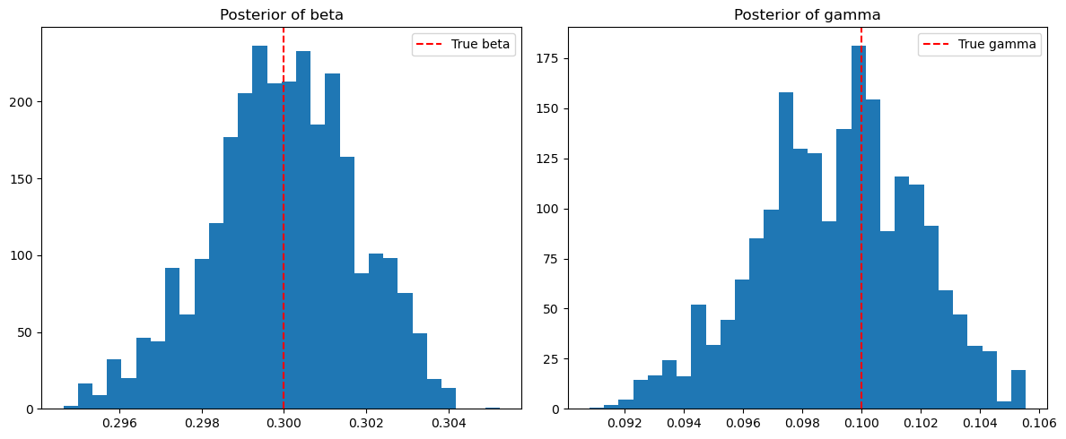
POSTERIOR ESTIMATION
Simulation Results
PARAMETER
TRUE VALUE
SAMPLE MEAN
SAMPLE VARIANCE
β
(Infection)
0.3
0.3001
0.000003
γ (Recovery)
0.1
0.0995
0.000006
METROPOLIS-HASTINGS ACCEPTANCE RATES
β
15%
γ
19%
5,000 post-burn-in samples
Ergodic convergence confirmed
Both posteriors are well-centered around true values. The γ posterior is tighter (lower variance), indicating the recovery rate is estimated with greater precision. The ergodic theorem confirms convergence to the target marginal distributions.

Slide 11
Limitations & Future Work
Strengths
Limitations & Extensions
Gibbs sampling effectively recovers true parameters (β, γ) from synthetic data with high accuracy
SIR model is simplistic — no births, deaths, or temporary immunity mechanisms
Provides full posterior distributions rather than point estimates, enabling uncertainty quantification
Synthetic data only — real-world data introduces additional noise and model misspecification
Convergence is mathematically guaranteed via the ergodic theorem for Markov chains
Could extend to SEIR, vaccination models, or stochastic epidemic models
RK4 ODE solver balances numerical accuracy with computational cost at each MCMC iteration
Advanced methods like Markov jump processes and prevalence probabilities (Fintzi et al., 2017) offer richer frameworks

Slide 12


Thank You
Questions?
"Gibbs sampling provides an effective, interpretable approach for epidemic parameter inference with natural extensions to more complex models."
Sai Nikhil Chanda
MATH 212 — Numerical Analysis
April 2026

